Slide 1
Crime Hotspot Prediction Max HAviv

Slide 2
Introduction
Cluster hotspots of crimes committed in Toronto from 2014-2019
K-Means clustering classified with K-Nearest-Neighbor
Density Based Clustering

Slide 3
Literature Review
Libraries used: pandas, numpy, matplotlib
Toronto MCI with around 180,000 crimes reported between 2014 and 2019. (Assault, Break and Enter, Robbery, Auto Theft, and Theft Over)

Slide 4
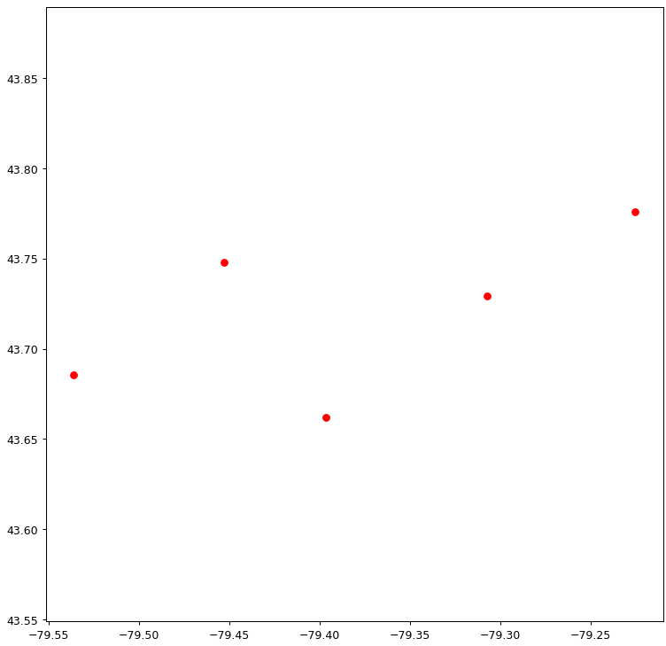
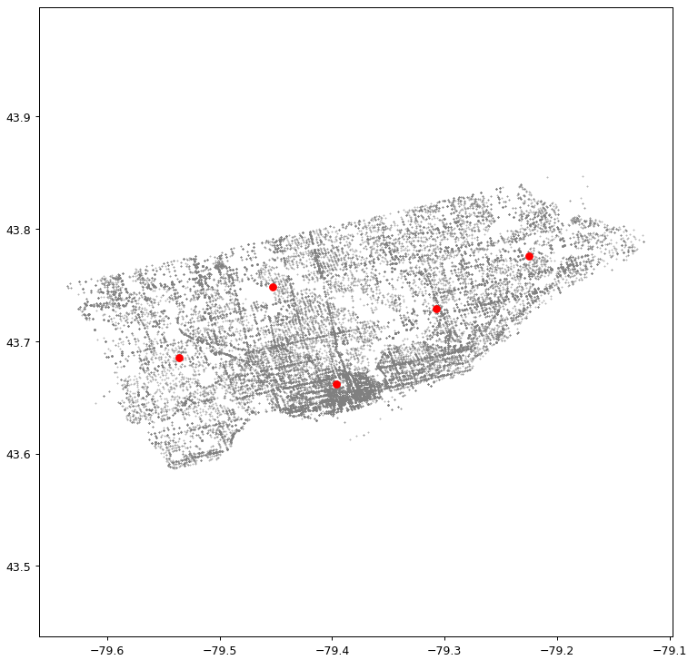
K-Means clustering

Slide 5
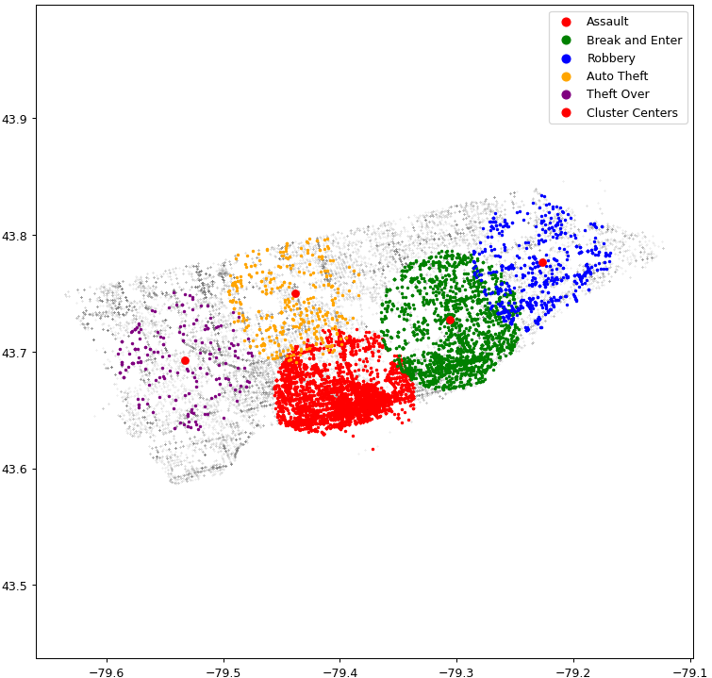
K-Means clusters classified with K-nearest-neighbor
Radius of 0.06 is set
All points within the cluster’s radius that also belong to the correct crime type are plotted in their respective color

Slide 6
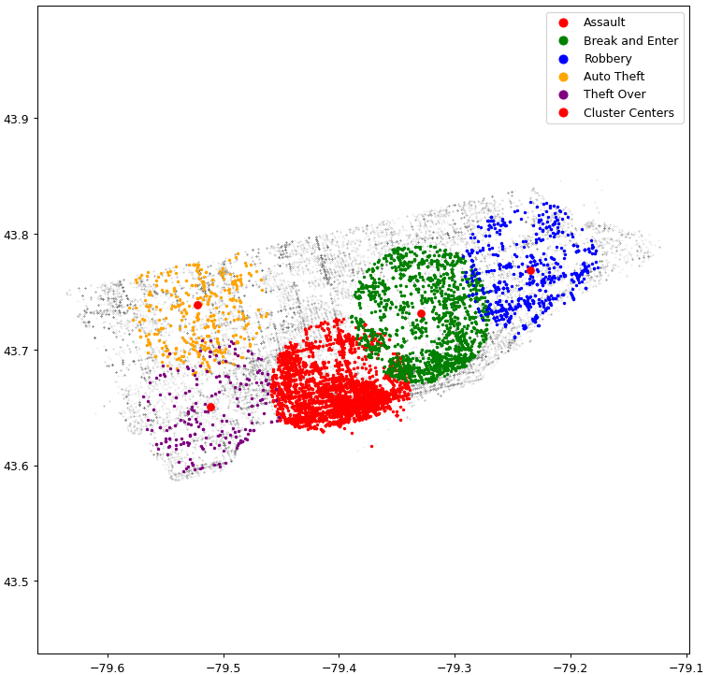
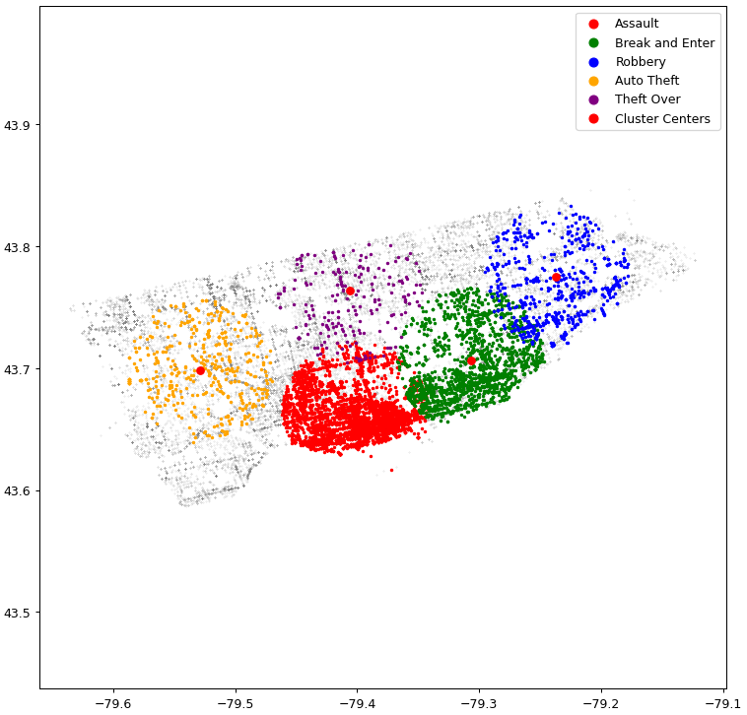
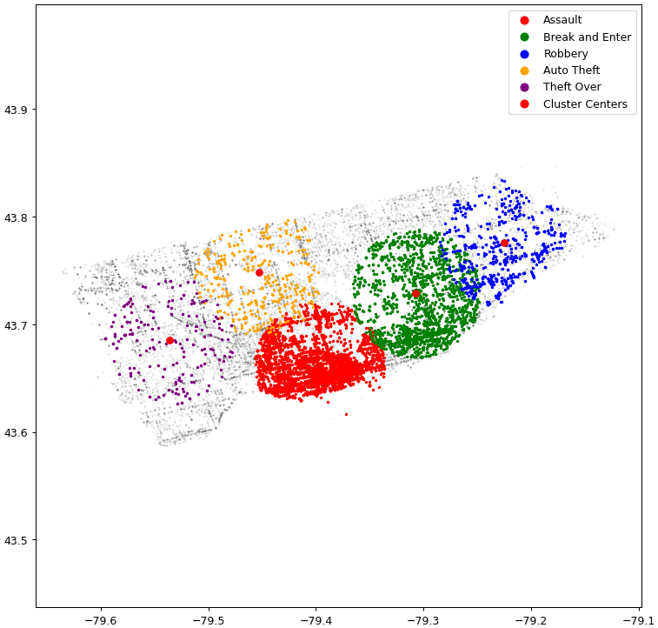
Multiple runs of K-means Clustering and KNN

Slide 7
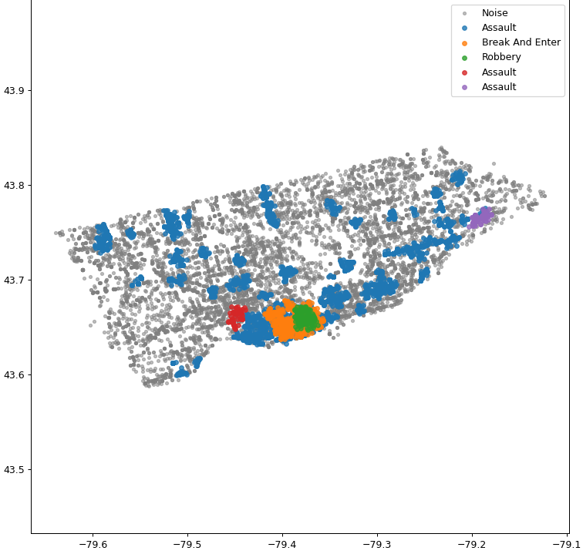
Density Based Clustering
Fit on Longitude, Latitude, and MCI
Set to only create five clusters
Radius of 0.005 and a minimum samples of 20

Slide 8
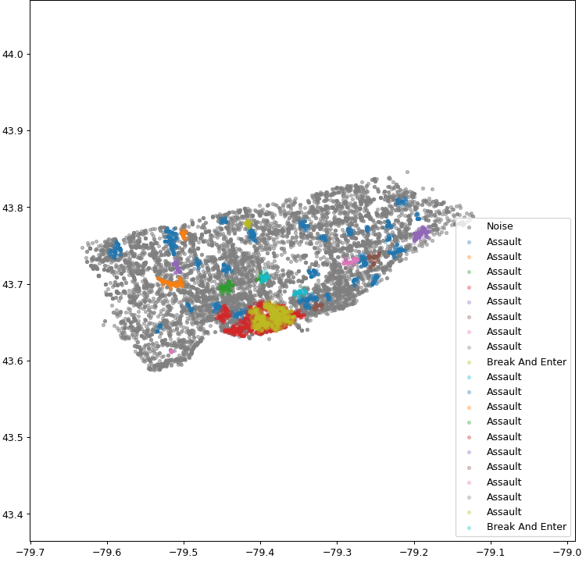
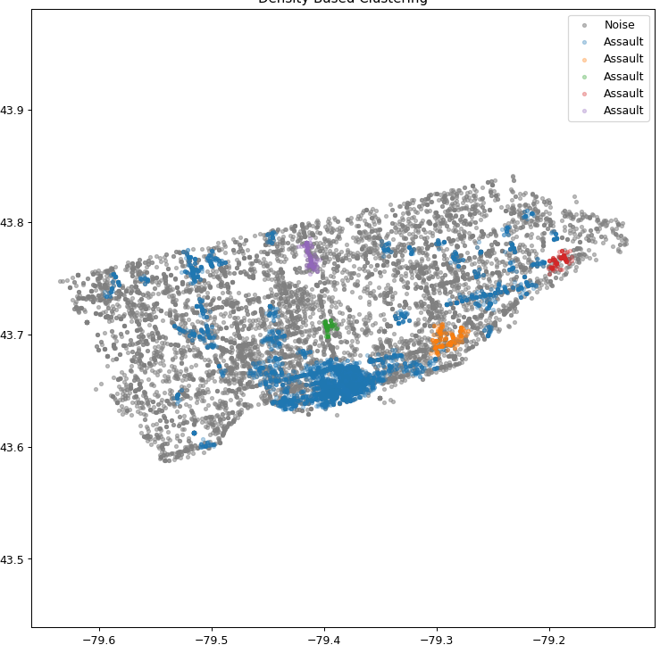
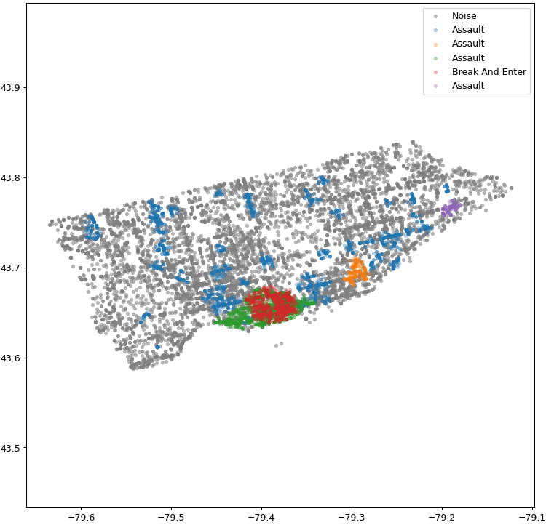
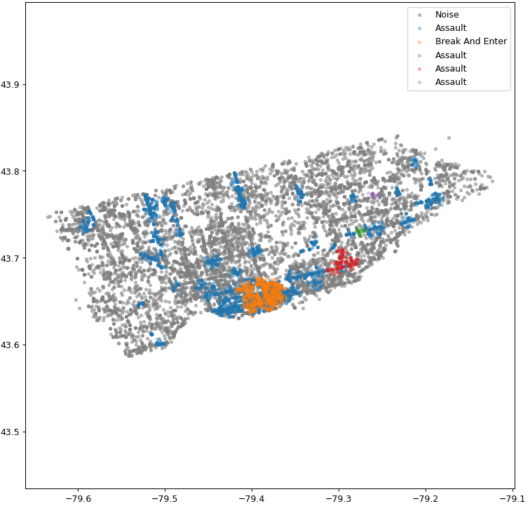
Multiple runs of density based clustering

Slide 9
References
K-Means Clustering
Luke, Turner. “Create a K-Means Clustering Algorithm from Scratch in Python.” Medium, Towards Data Science, 3 May 2022, towardsdatascience.com/create-your-own-k-means-clustering-algorithm-in-python-d7d4c9077670.
Density Based Clustering
Ali, Moosa. “DBSCAN Clustering Algorithm Implementation from Scratch: Python.” Medium, Becoming Human: Artificial Intelligence Magazine, 29 Nov. 2021, becominghuman.ai/dbscan-clustering-algorithm-implementation-from-scratch-python-9950af5eed97.ring

